Slide 1
Raft
An understandable consensus algorithm
项目宣讲
Made Simple

Slide 2
01
什么是Raft
What is Raft
目录
02
实现与细节
CONTENTS
Implement and details
03
要求
Requirements

Slide 3

第一部分
PART 01
什么是Raft
Raft is a consensus algorithm for managing a replicated log. It produces a result equivalent to (multi-)Paxos, and it is as efficient as Paxos, but its structure is different from Paxos; this makes Raft more understandable than Paxos and also provides a better foundation for building practical systems.

Slide 4
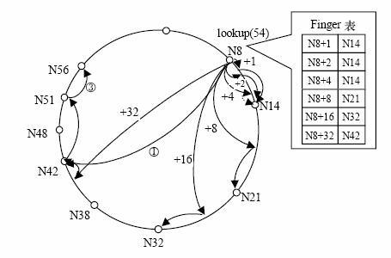
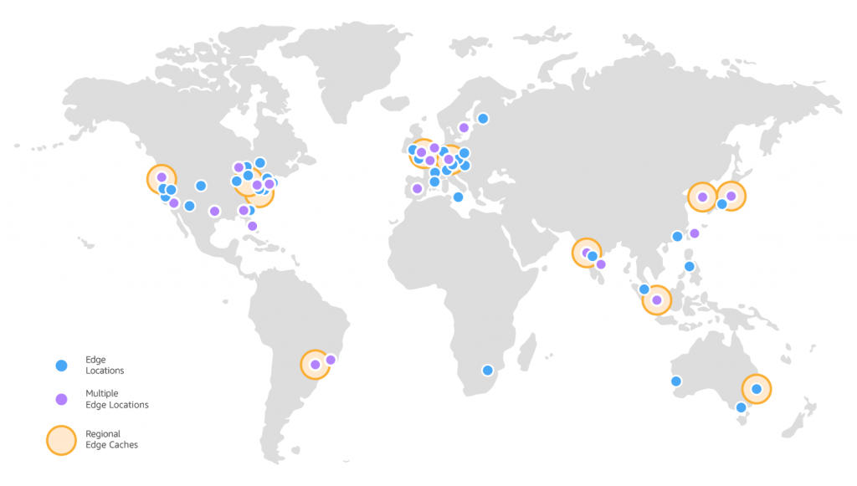
从一致性consensus讲起
走错片场的弦图
虚构的Amazon数据中心分布图
定义：一致性算法
组织机器使其状态最终一致并允许局部失败的算法。
图源网络

Slide 5
一致性consensus，阻碍为何
网络延迟
分区
丢包
冗余个别服务器停机或缓慢
非拜占庭错误
一致性算法目标
安全性保证：在非拜占庭错误况下，都可以保证正确。
可用性：集群中只要有大多数的机器可运行并且能够相互通信、和客户端通信，就可以保证可用。
不依赖时序来保证一致性：物理时钟错误或者极端的消息延迟，只有在最坏情况下才会导致可用性问题
快速响应：通常情况下，一条指令可以尽可能快的在集群中大多数节点响应一轮远程过程调用时完成。小部分比较慢的节点不会影响系统整体的性能。

Slide 6
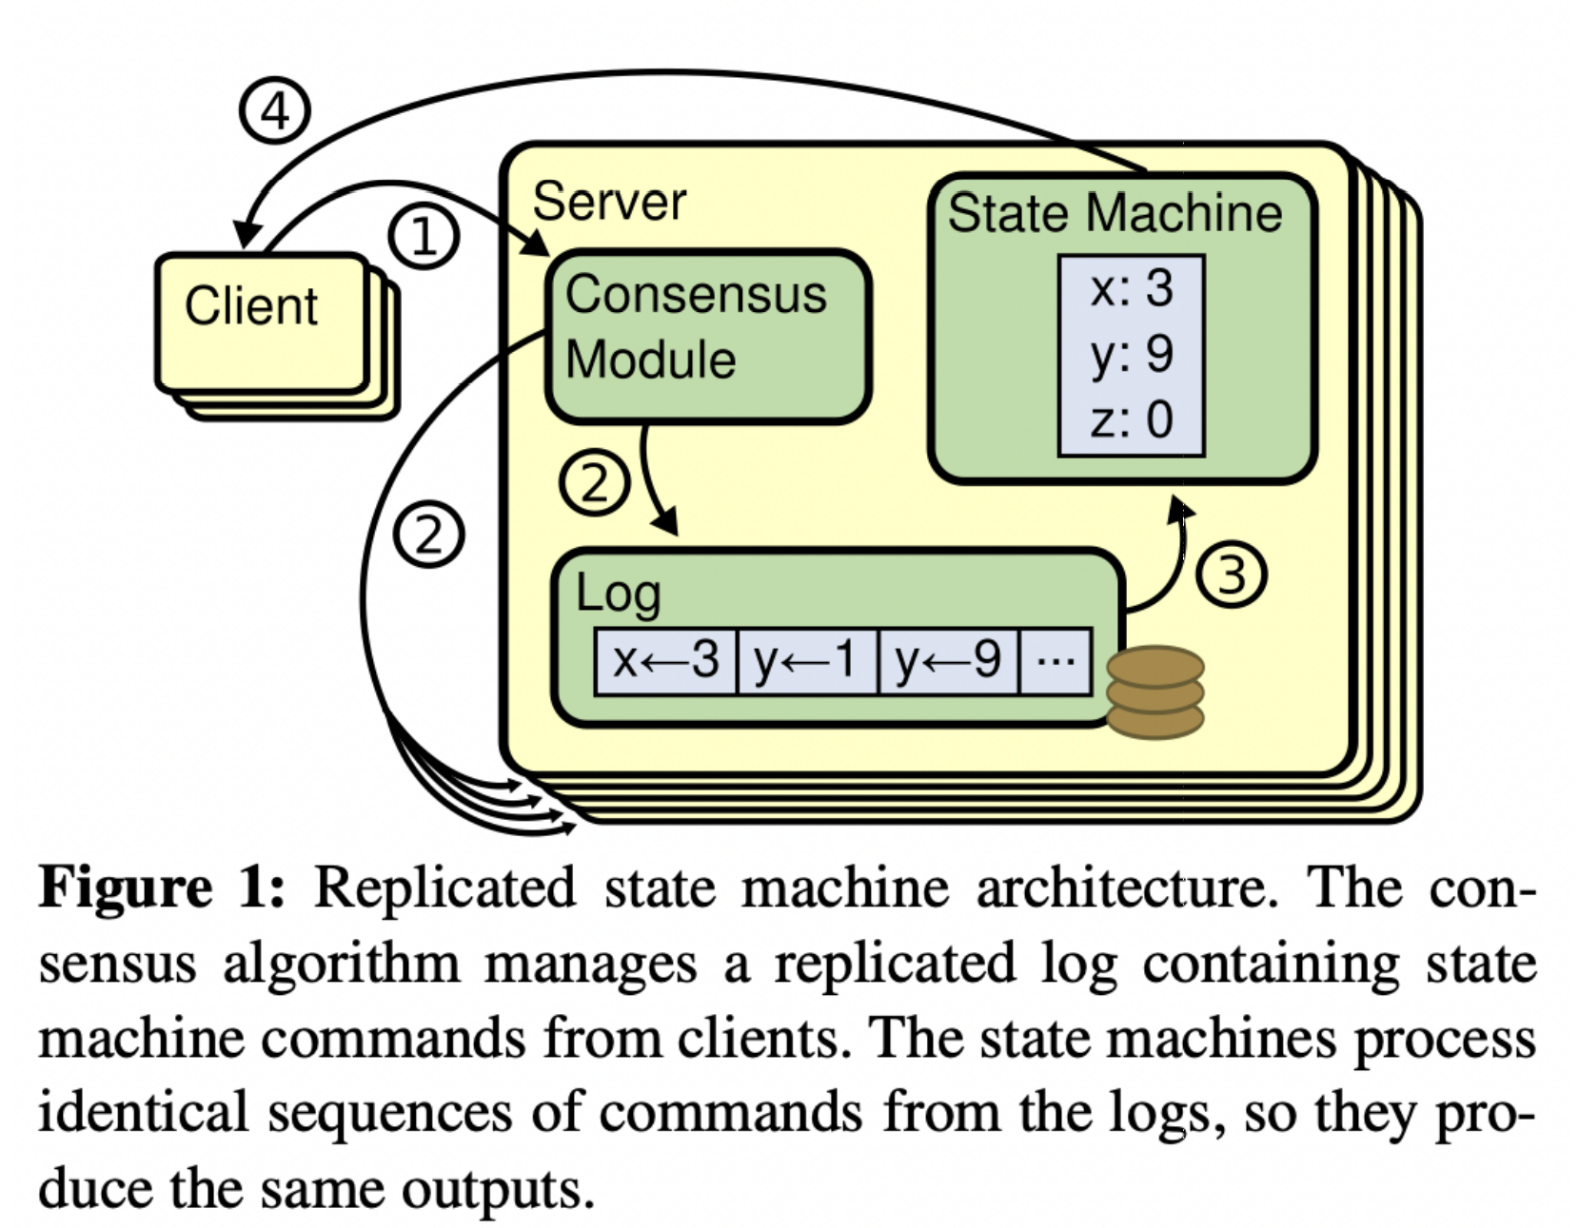
Raft Server模型
GitHub - maemual/raft-zh_cn: Raft一致性算法论文 图片出处

Slide 7
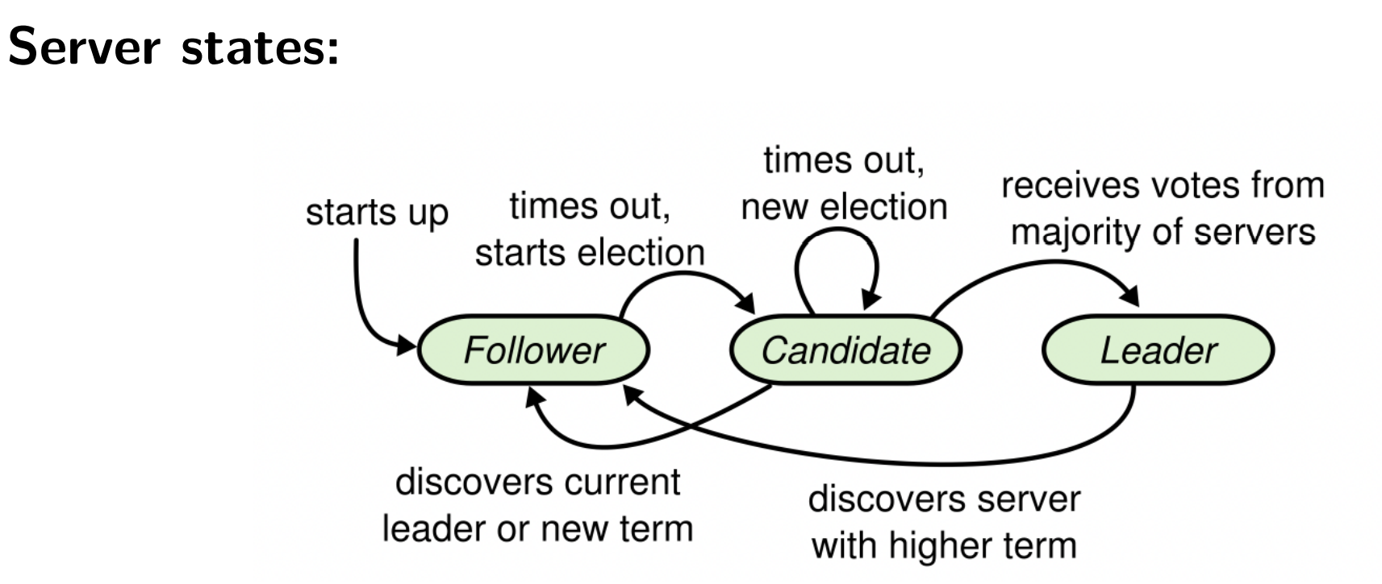
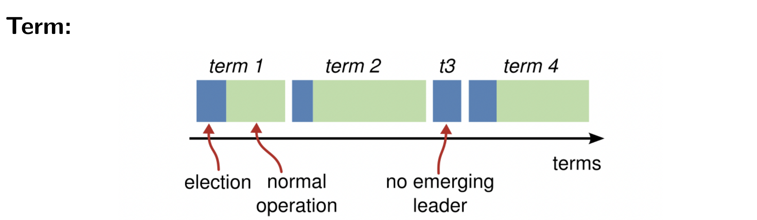
强领导人机制
领导人（Leader）
跟随者（Follower）
候选人（Candidate）
Role的转换图
时间/任期为轴的图

Slide 8
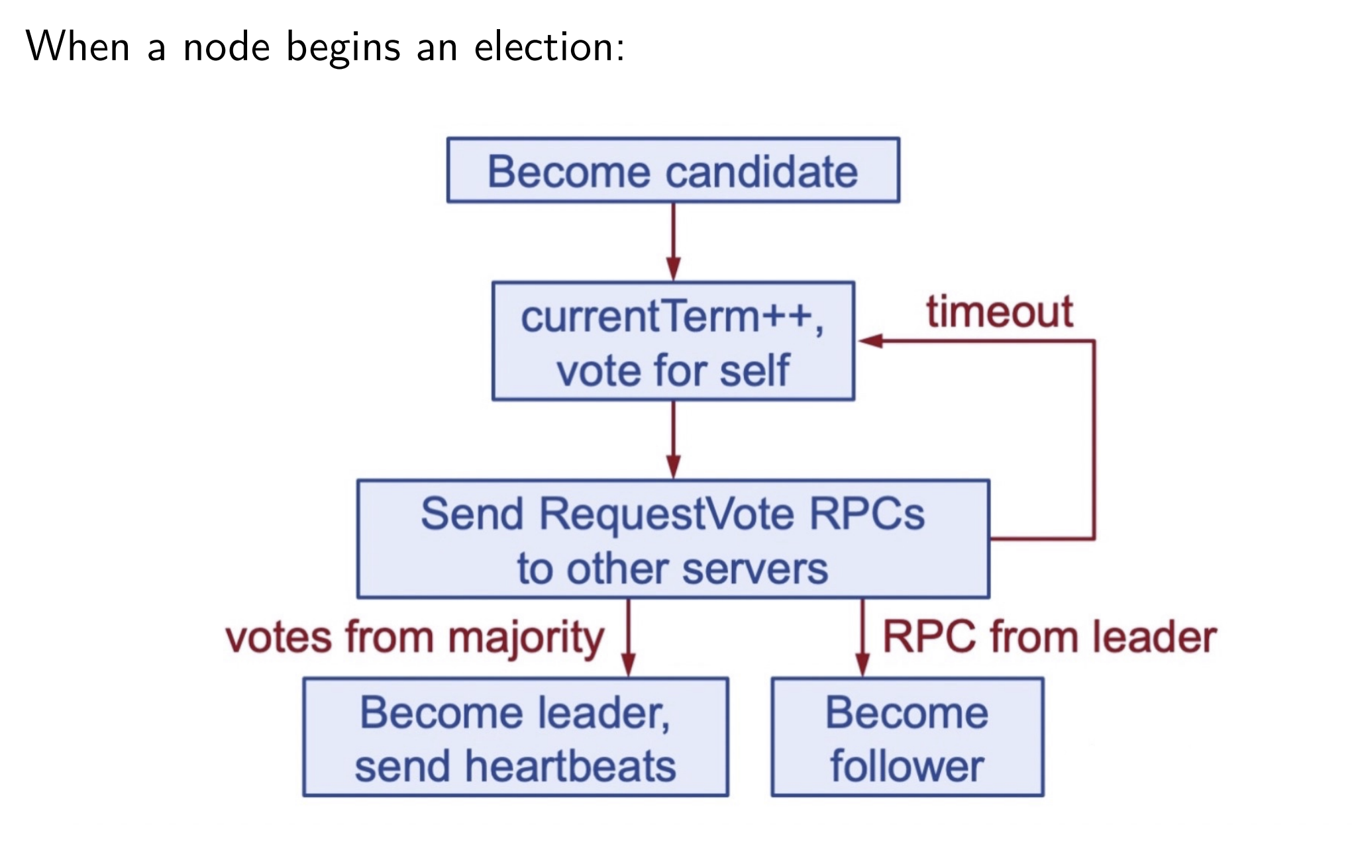
StartElection
A first-come-first-served basis
Election restriction
A candidate must contact a majority of the cluster in order to be elected, which means that every committed entry must be present in at least one of those servers. If the candidate’s log is at least as up-to-date as any other log in that majority (where “up-to-date” is defined precisely below), then it will hold all the committed entries.
Randomized election timeouts
ppt of Xinyu Yang图片出处

Slide 9
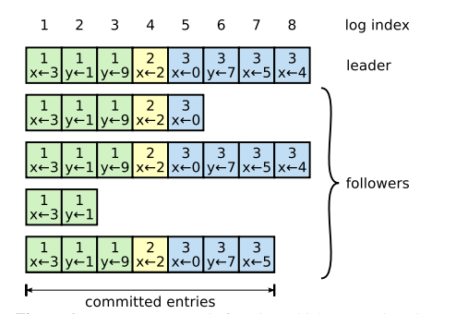
Raft Server模型——log
Log的分类
Successfully-Appended
Committed
Applied
Compacted
GitHub - maemual/raft-zh_cn: Raft一致性算法论文 图片出处

Slide 10
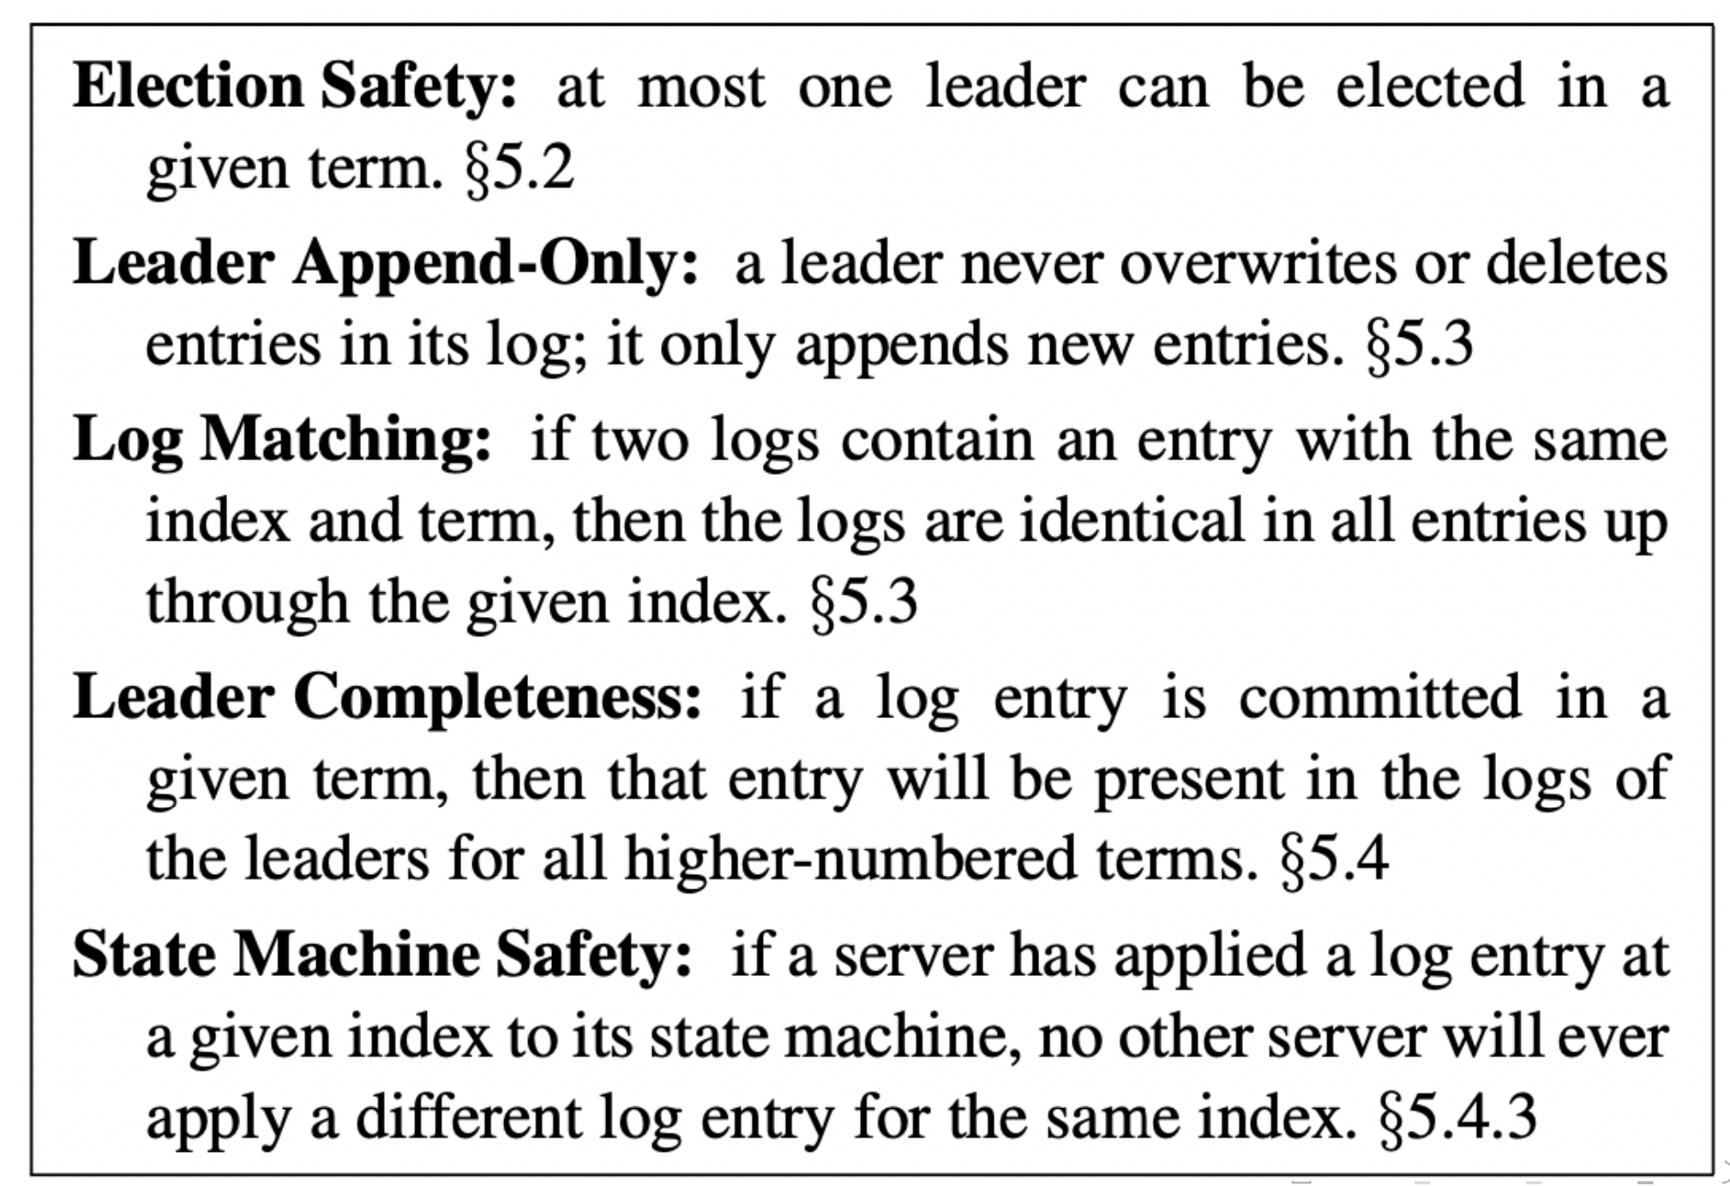
Safety – five properties

Slide 11
第二部分
PART 02
实现与细节

Slide 12
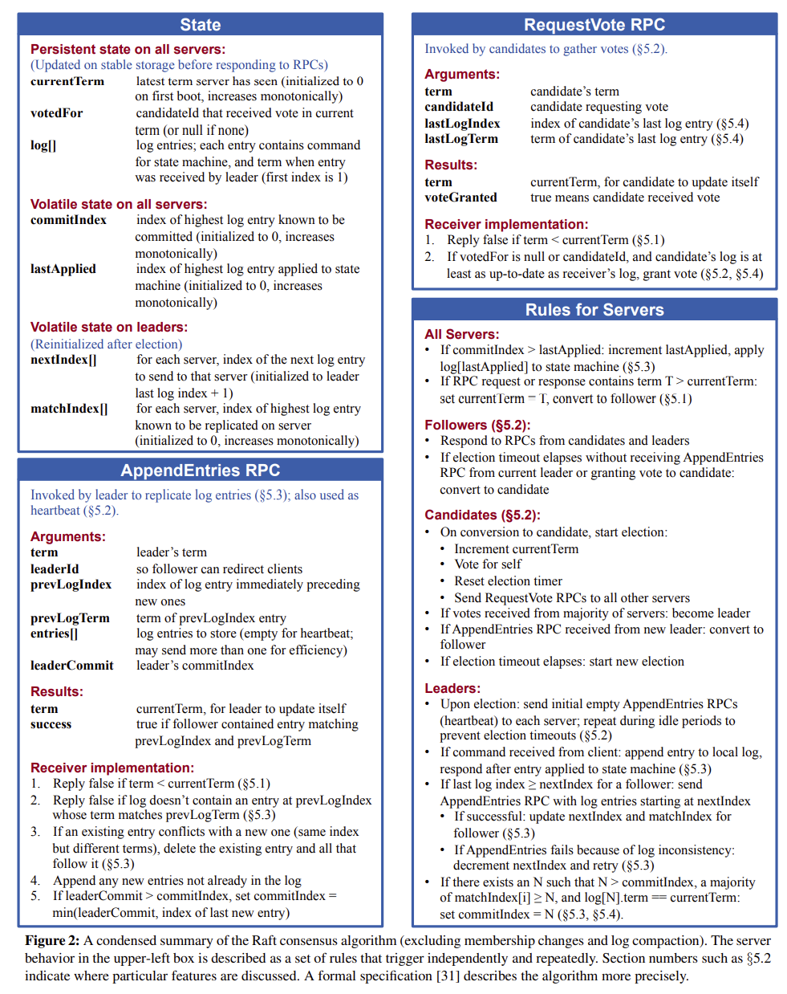
Our Bible
GitHub - maemual/raft-zh_cn: Raft一致性算法论文 图片出处

Slide 13
Raft Server模型——HeartBeat
Leader receives a command from client
Append the log to this server
1
Start the agreement by sending RPC to followers
Leader
2
3
Follower
Follower
4
5
Follower
Follower
Demo
http://thesecretlivesofdata.com/raft/

Slide 14
Raft Server模型——HeartBeat
1
Start the agreement by sending RPC to followers
Leader
2
3
Follower
Follower
Package lose
Long delay
4
5
When Follower crash or timeout：Leader repeat sending RPC
Follower
Follower
Thesecretofdata 参考

Slide 15
Raft Server模型——HeartBeat
Receives RPCs from more than half servers (including itself)
1
Leader
Append the entry to its own log
Send back RPC to leader
2
3
Follower
Follower
Package lose
4
5
Long delay
Follower
Follower
Thesecretofdata 参考

Slide 16
Raft Server模型——HeartBeat
Send commit signal to followers
1
Leader
On receiving the signal, move the commit index
2
3
Follower
Follower
Real situation:
Commit signal, append entries, log matching
All in one RPC
4
5
Follower
Follower
Thesecretofdata 参考

Slide 17
第三部分
PART 03
要求

Slide 18
Requirements
工作安排
第一周：学习go语言
第二周：阅读raft原论文
第三周：完成Lab 2(A) & Lab 2(B)
第四周：完成Lab 2(C) & 尝试bonus
ppt of Xinyu Yang图片出处

Slide 19
祝大家暑假愉快

